Slide 1

An ecotoxicology case study for Danube River
Isil Erbasol Serbes
Hungarian Parliament Building by the Danube River in Budapest
http://tinyurl.com/2s4b99hz

Slide 2
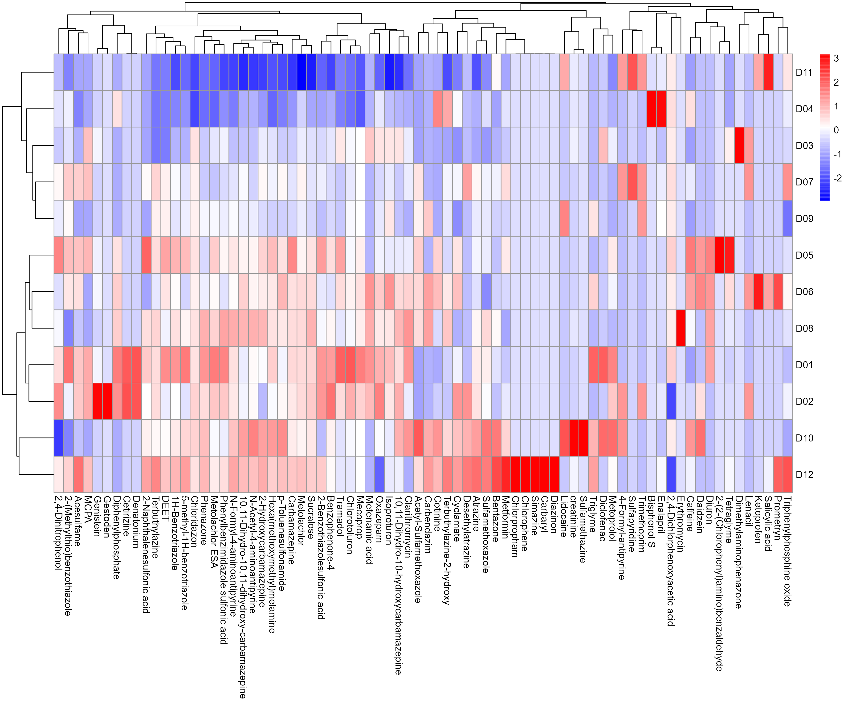
Understanding the chemical concentrations in 12 sites
Group1
Group2
Data is standardized, and zero count chemicals are removed. Pheatmap package was used to generate the heatmap.

Slide 3
Understanding the impact of fresh-water quality on Daphnia Magna
Group1 members “D11,D04, D03, D07 and D09”are a relatively clean freshwater sites. Whereas
Group2 members “D05, D06, D08,D01, D02, D10 and D12” are much toxic freshwater sites in Danube river.
How does this chemical composition difference in Group1 and Group2 impact on Daphnia?
Can we find out any important biological respond pathways changes in different groups?

Slide 4
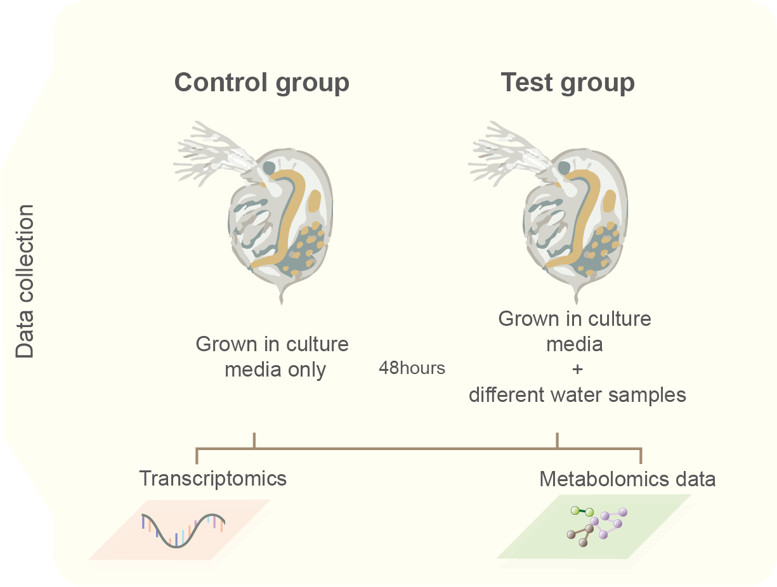
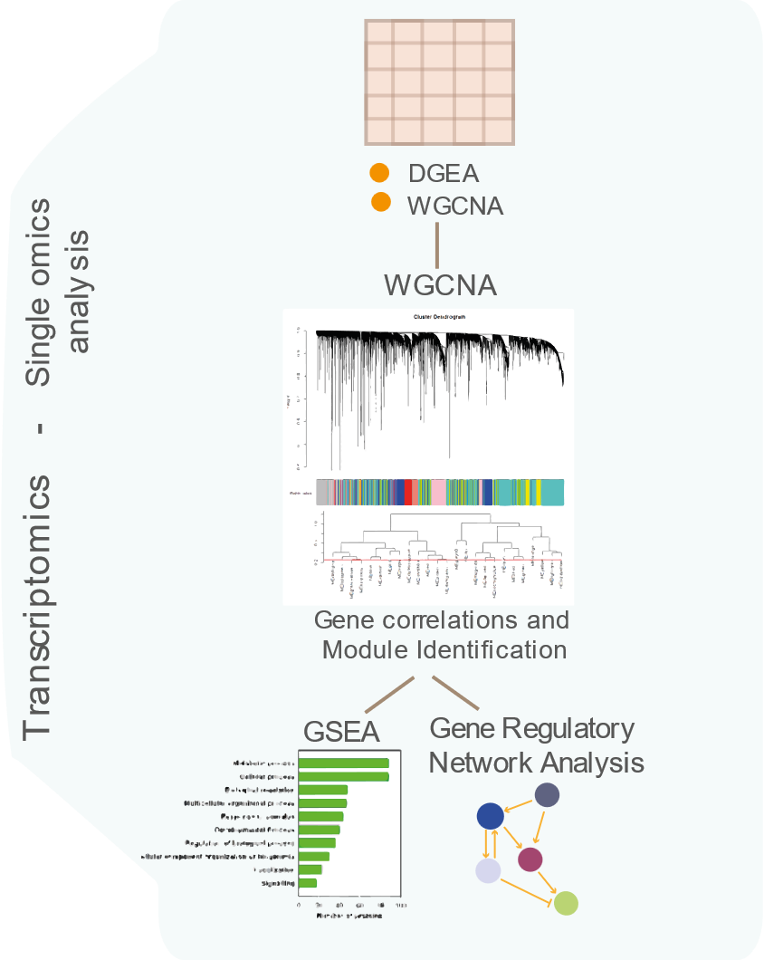
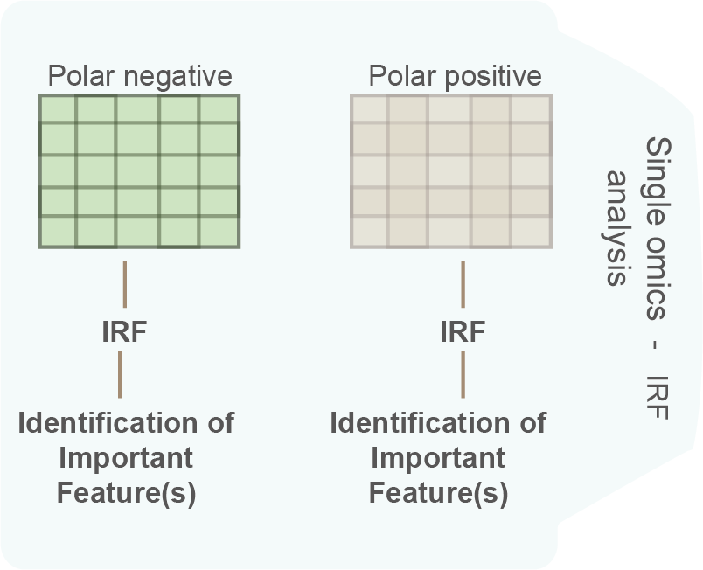
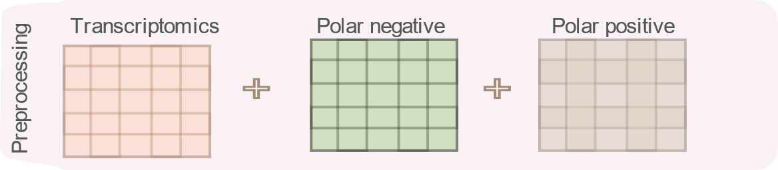
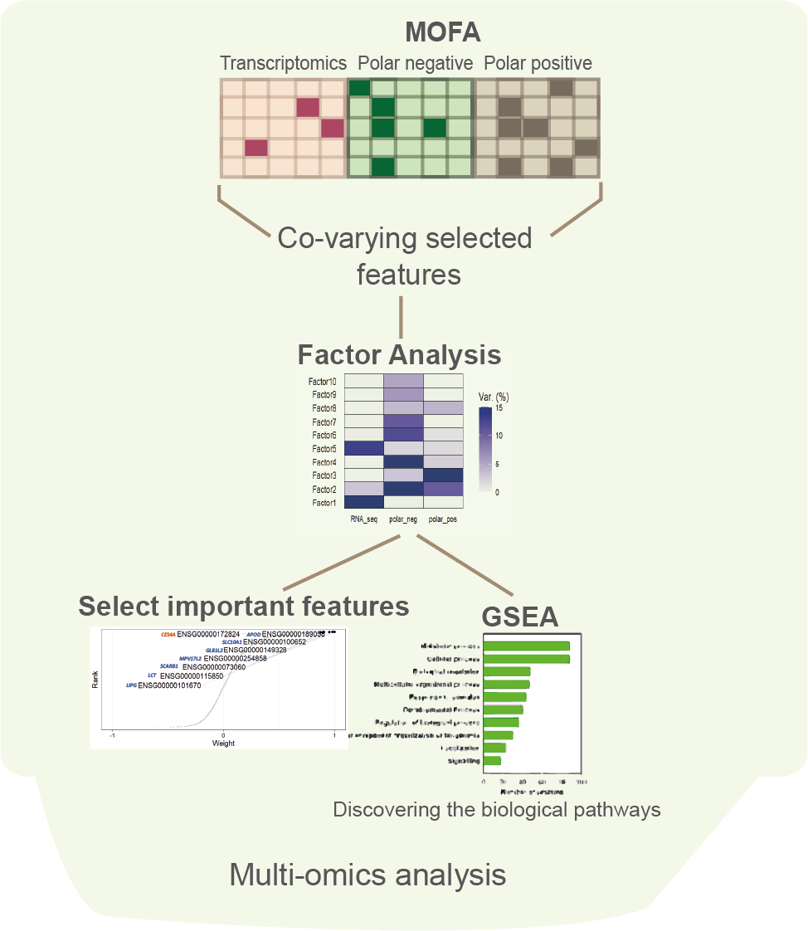
Analysis workflow
Group1(1X-less contaminated with chemicals): D03,D04,D07,D09,D11
Group2(1X-more contaminated with chemicals): D01,D02,D05,D06,D08,D10,D12

Slide 5
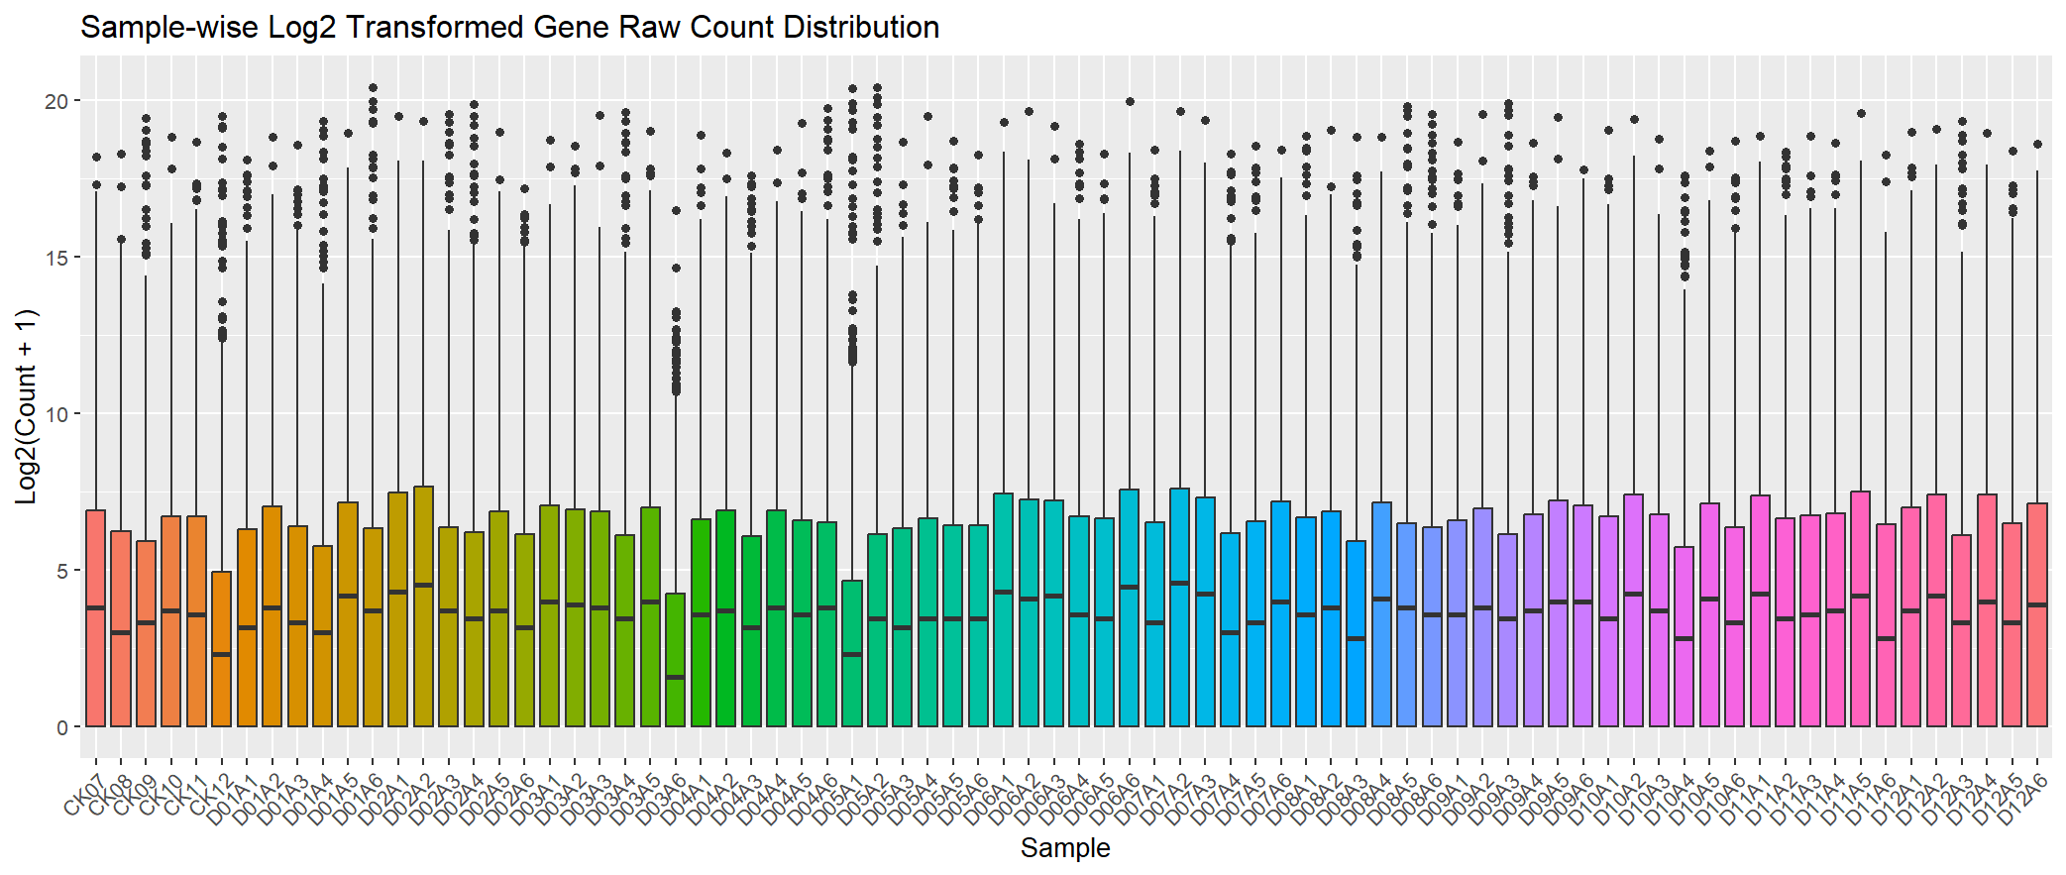
QC check before DGEA

Slide 6
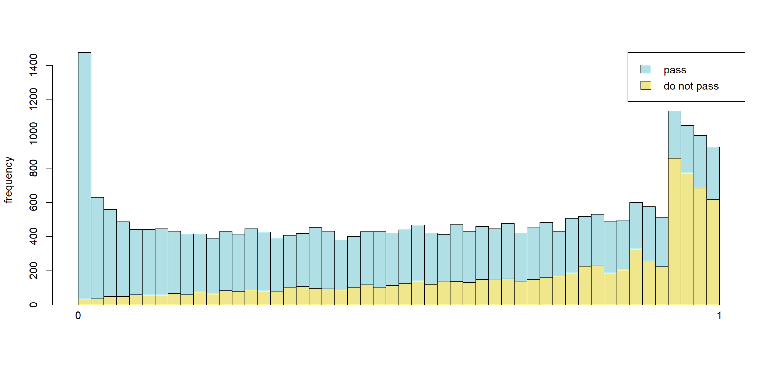
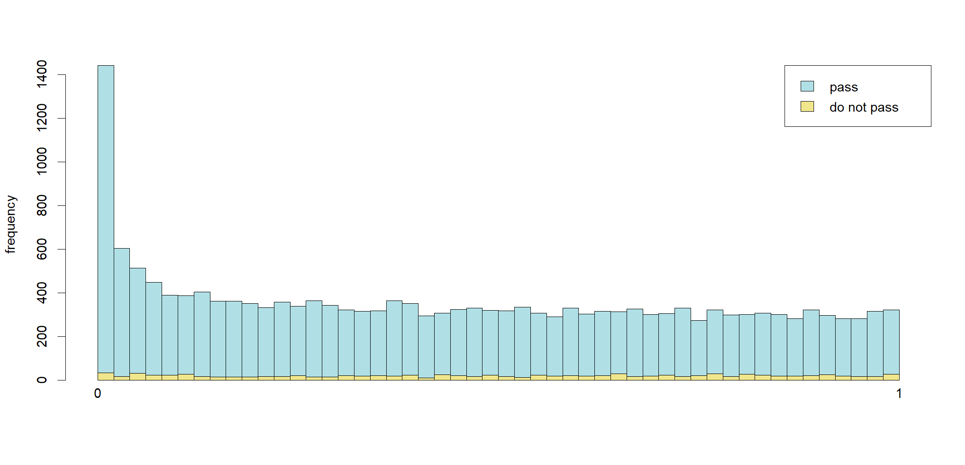
DEG analysis with DESeq2 package-QC check the results
No filtering to low_counts p-value distribution
After filtering low_counts- p-value distribution
alpha= 0.05

Slide 7
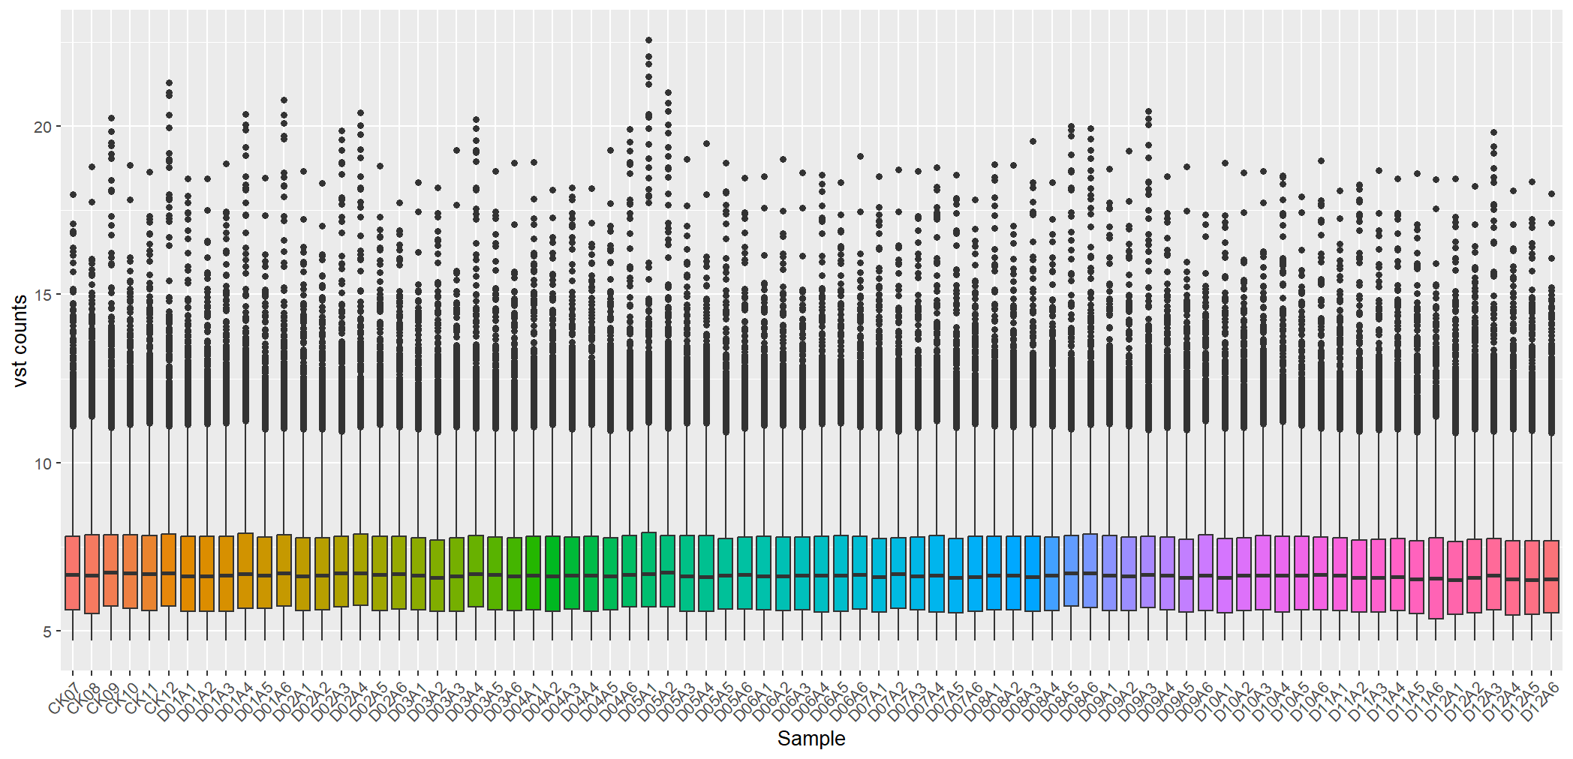
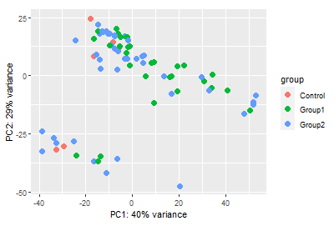
DEG analysis-QC check the results
PCA plot for top500 features with vst counts

Slide 8
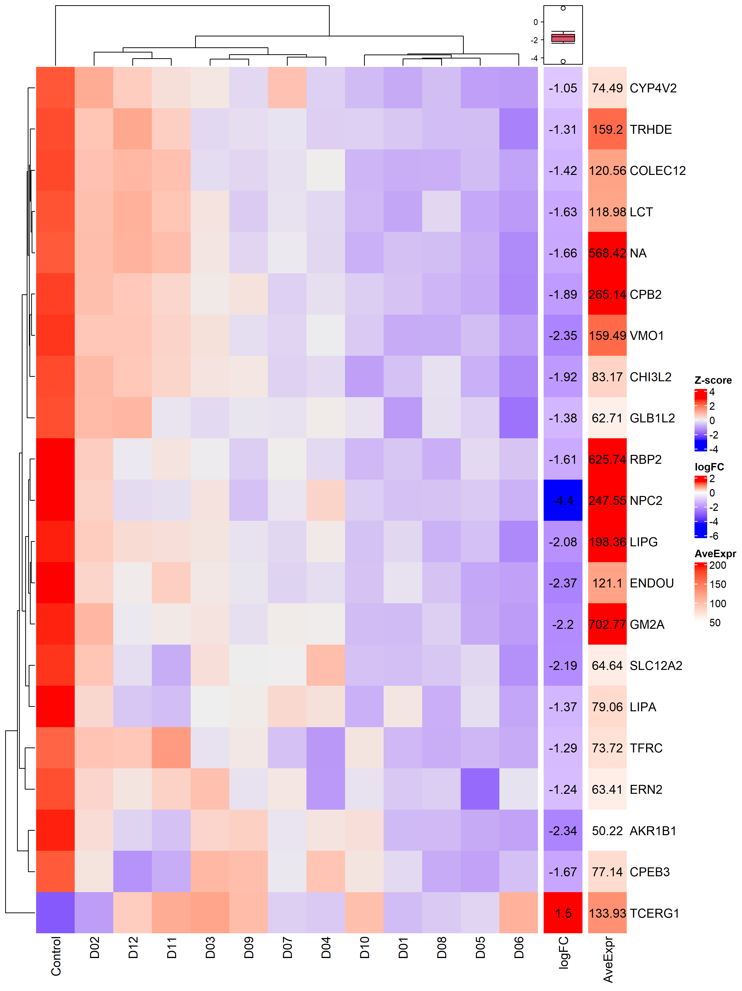
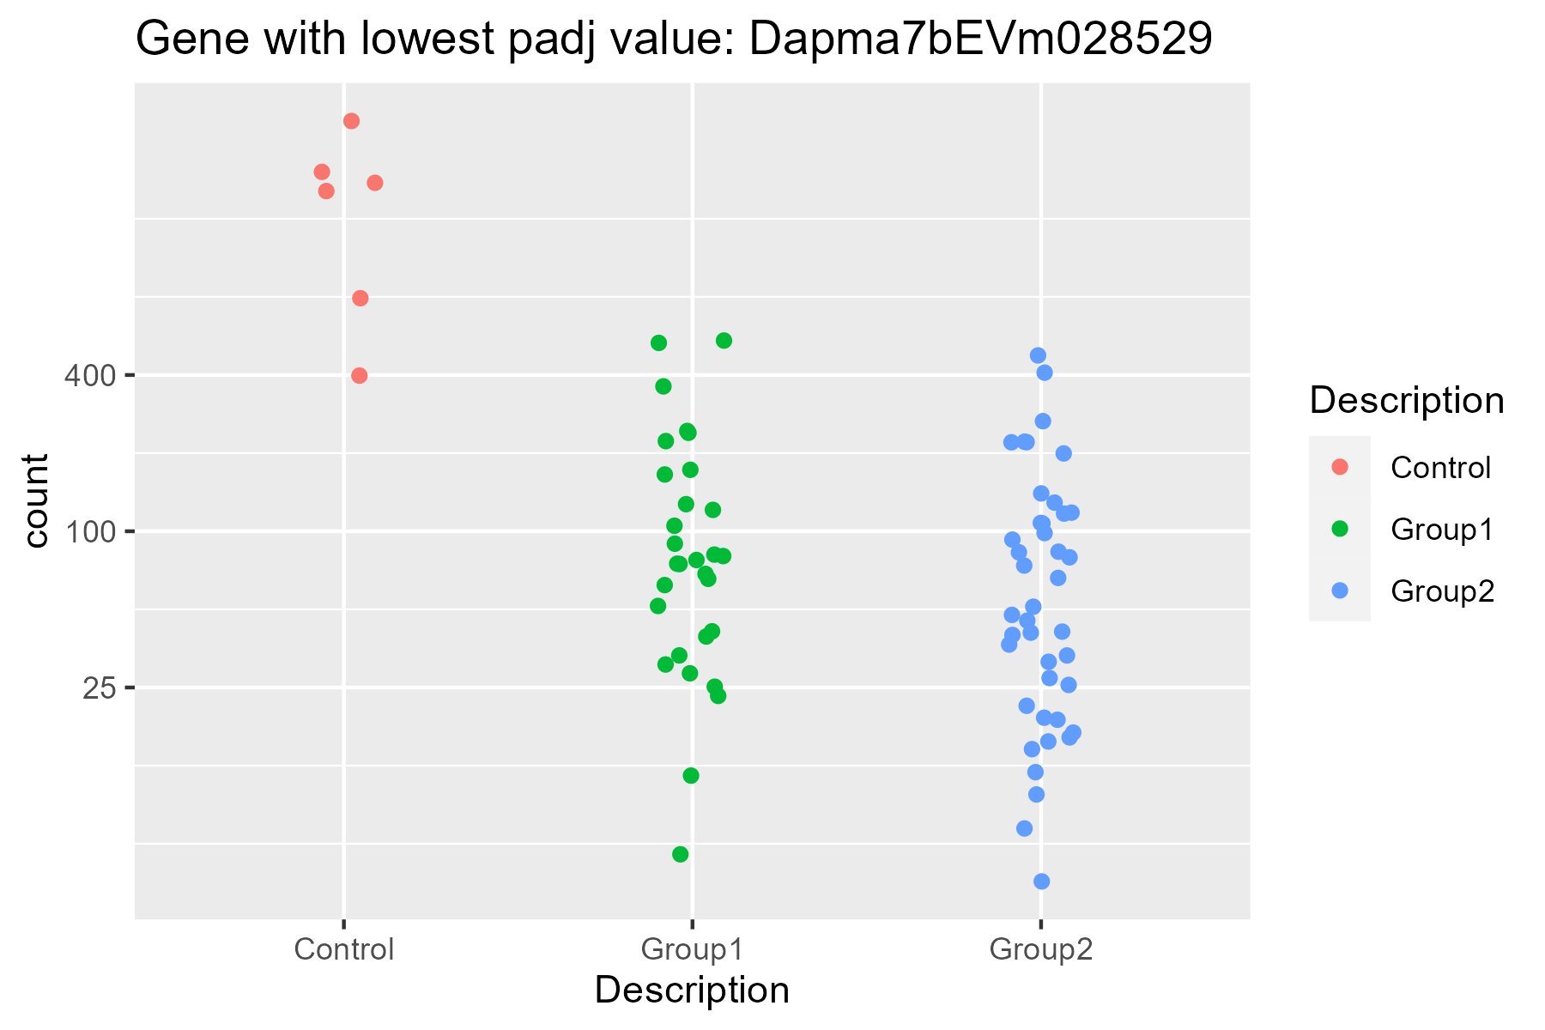
DEG analysis results
Gene with lowest padj value: NPC2 (Dapma7bEVm028529)
NPC2 functions in regulating the transport of cholesterol
Group1-less contaminated with chemicals)
Group2- more contaminated with chemicals
padj<0.05 & baseMean>50 $ abs(log2FoldChange)> 1

Slide 9
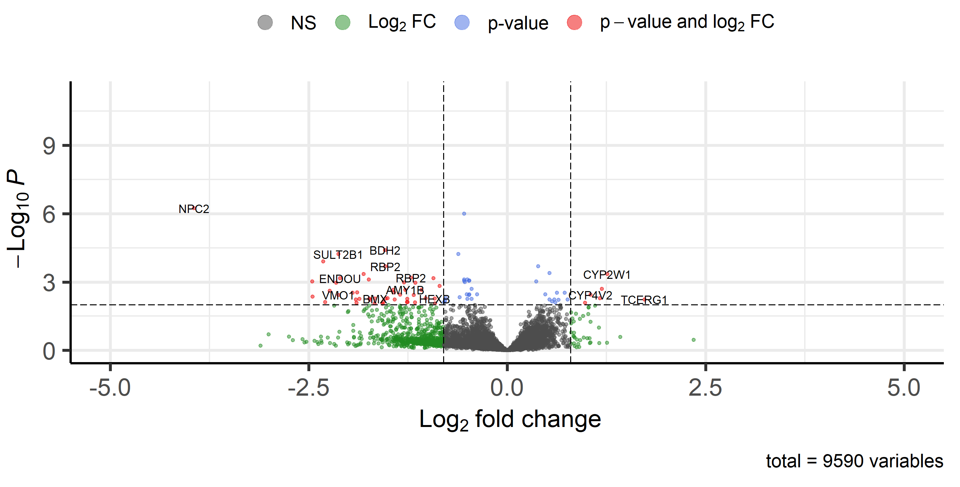
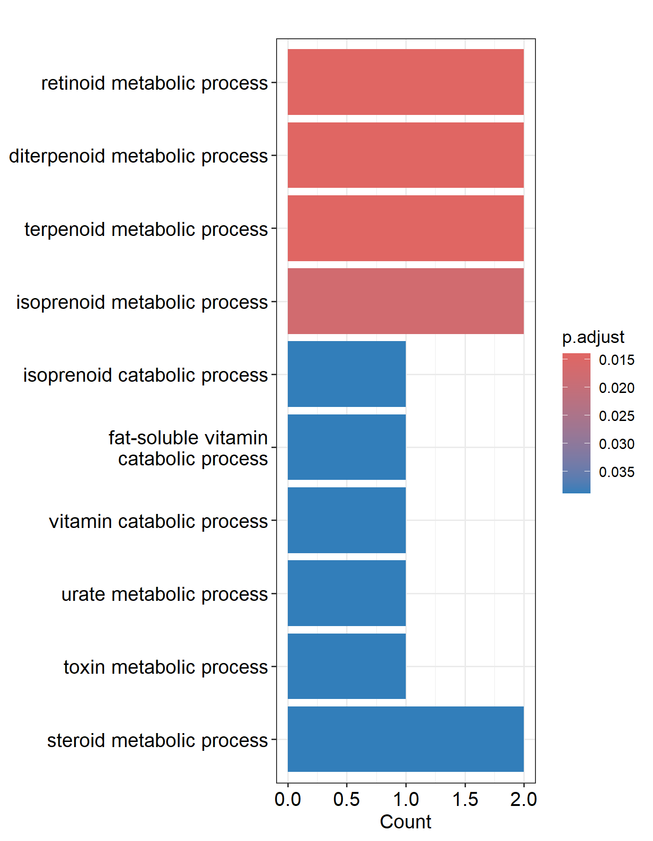
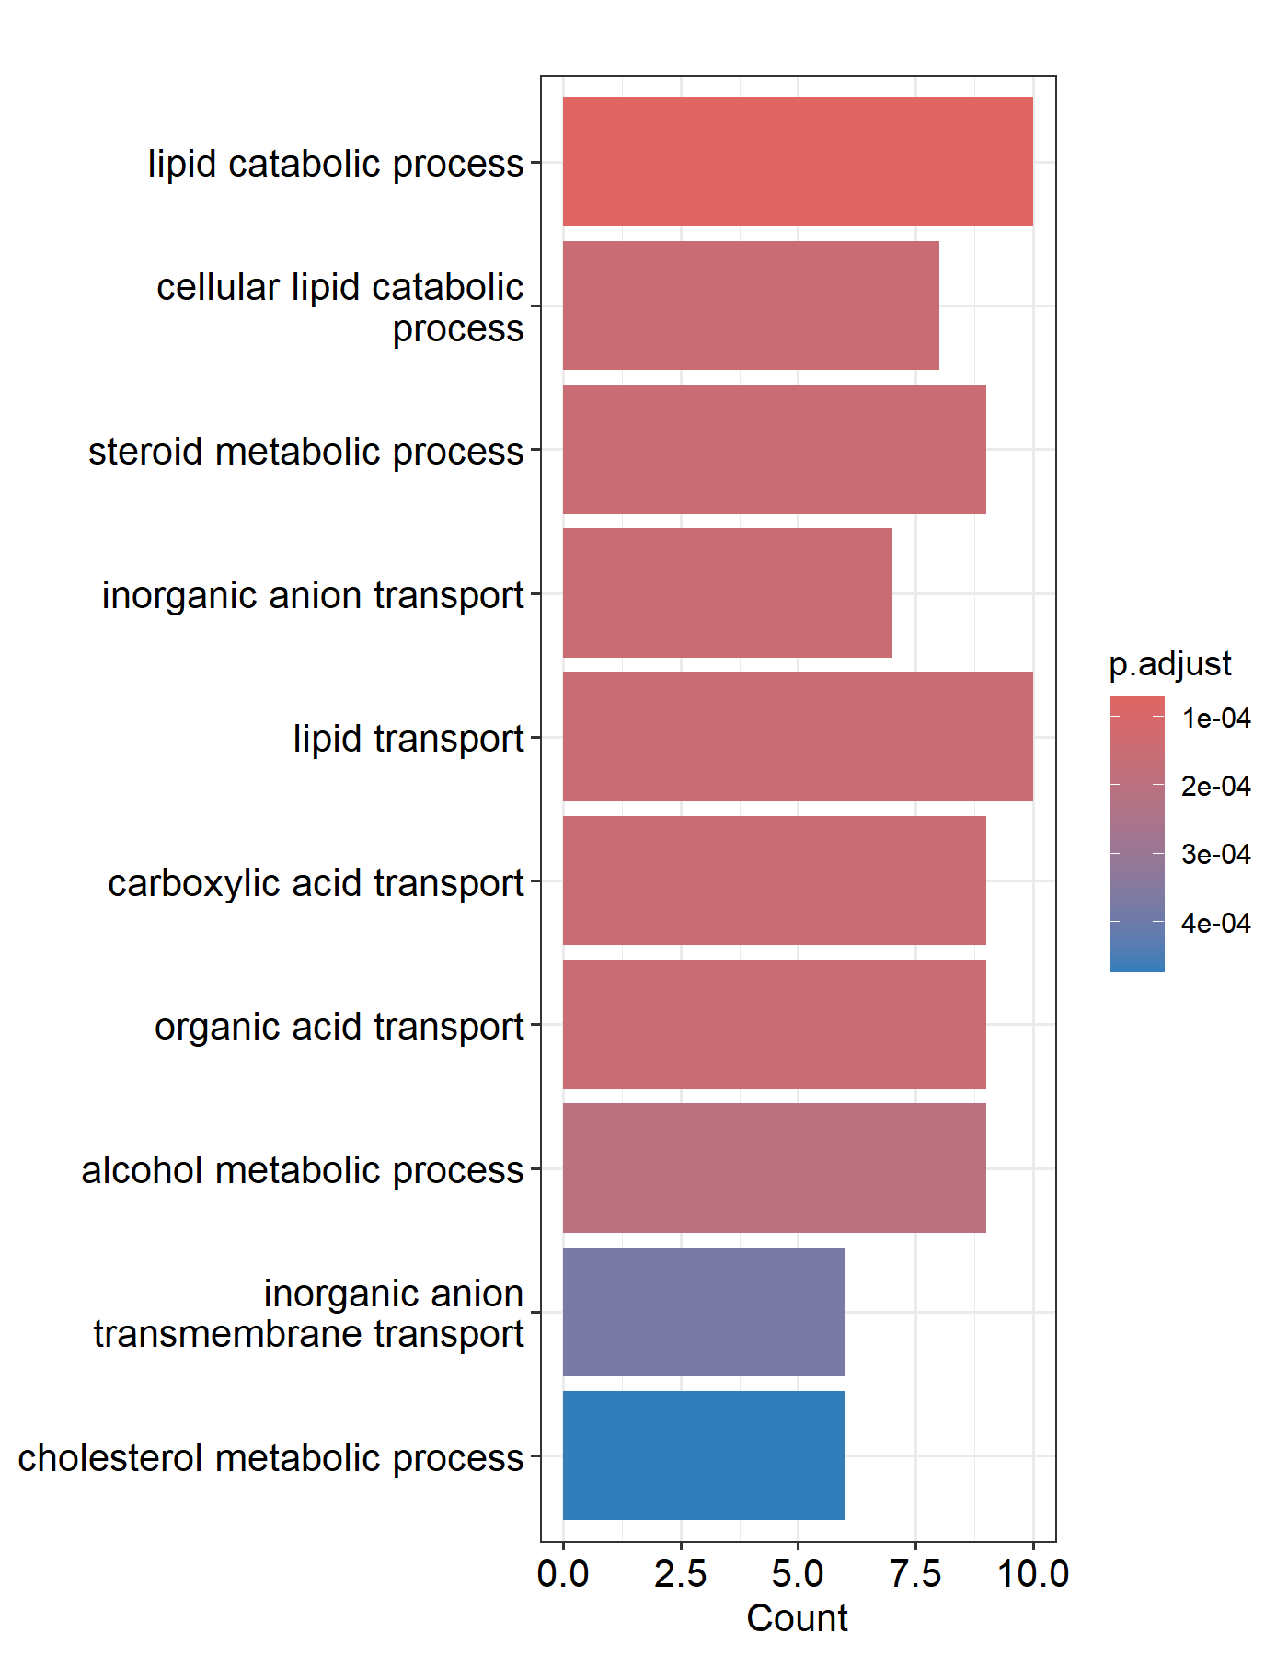
DEG analysis and GO enrichment pathway analysis results-Group1
GSEA* for top significantly upregulated genes
(logFC > +1)
GSEA for top significantly downregulated genes
(logFC< -1)
*Gene onthology (GO)

Slide 10
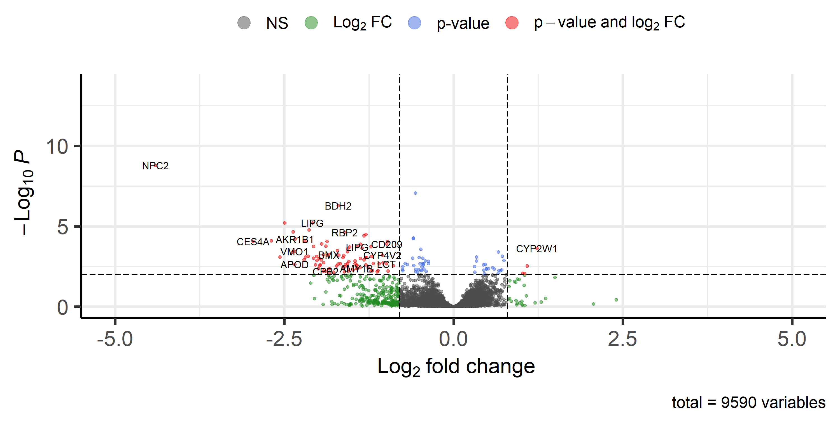
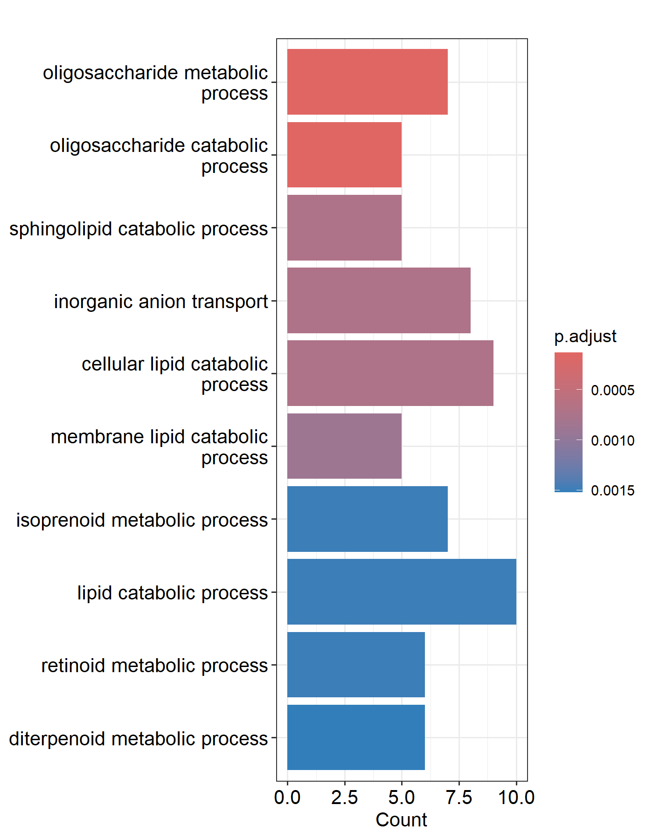
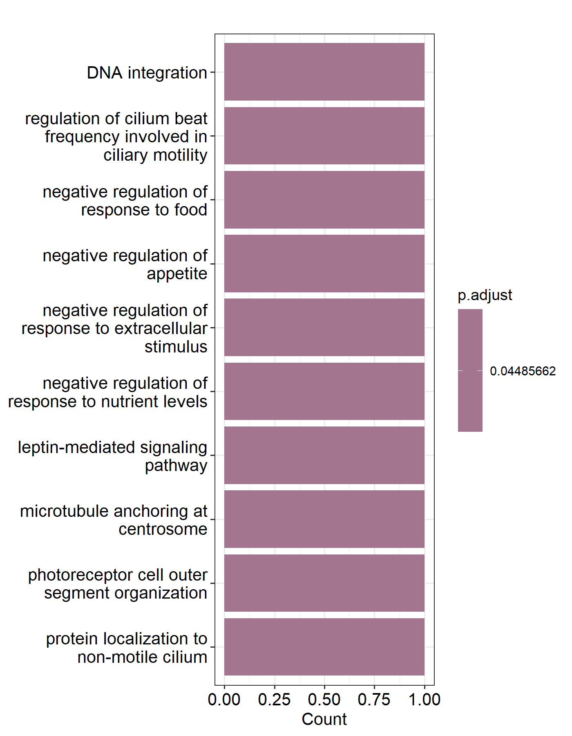
DEG analysis and GO enrichment pathway analysis results-Group2
GSEA* for top significantly upregulated genes
(logFC > +1)
GSEA for top significantly downregulated genes
(logFC< -1)
*Gene onthology (GO)

Slide 11
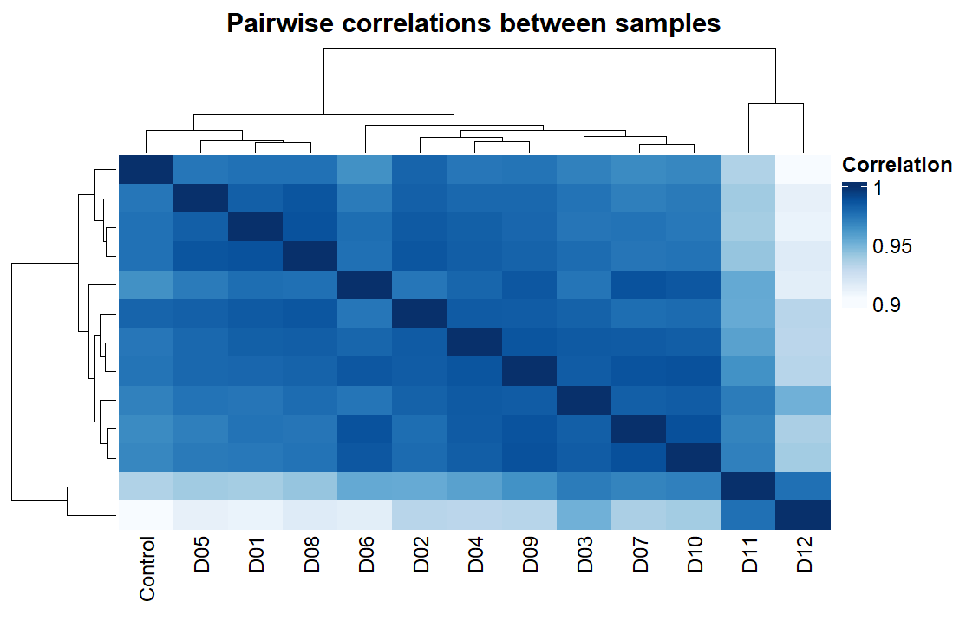
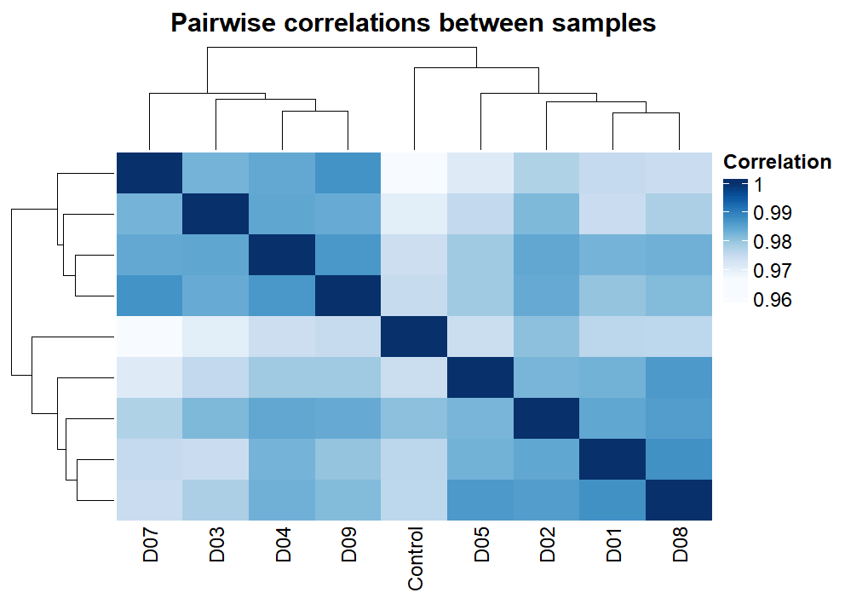
WGCNA analysis with BioNERO package –QC check
Group1-less contaminated with chemicals)
Group2- more contaminated with chemicals
removed

Slide 12
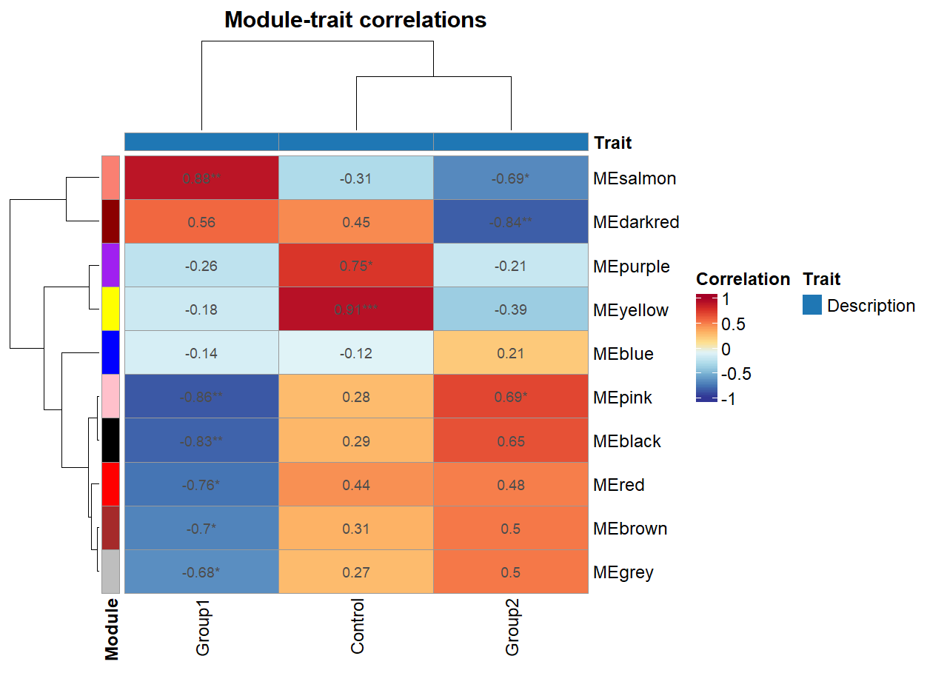
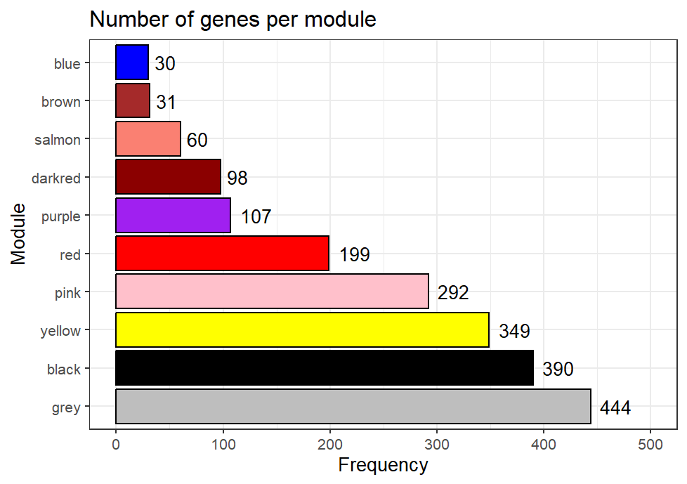
WGCNA results

Slide 13
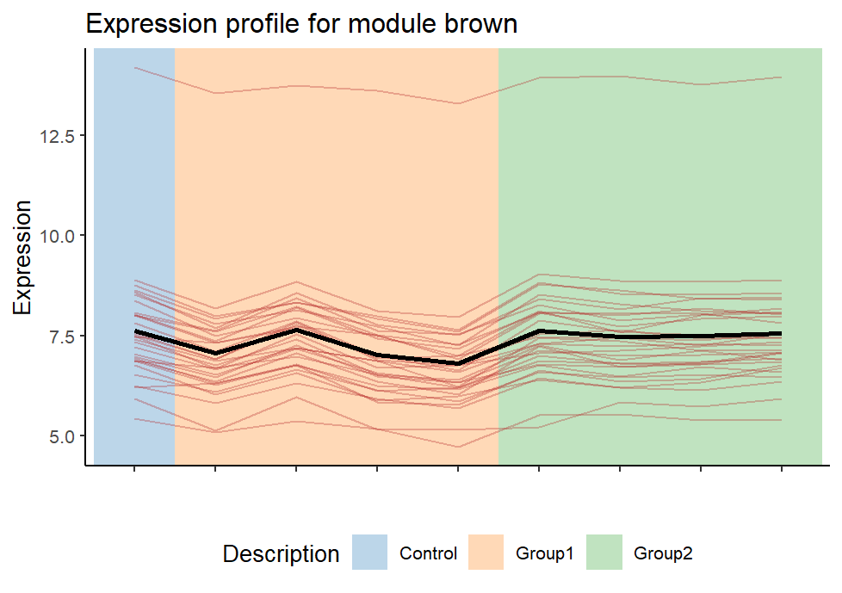
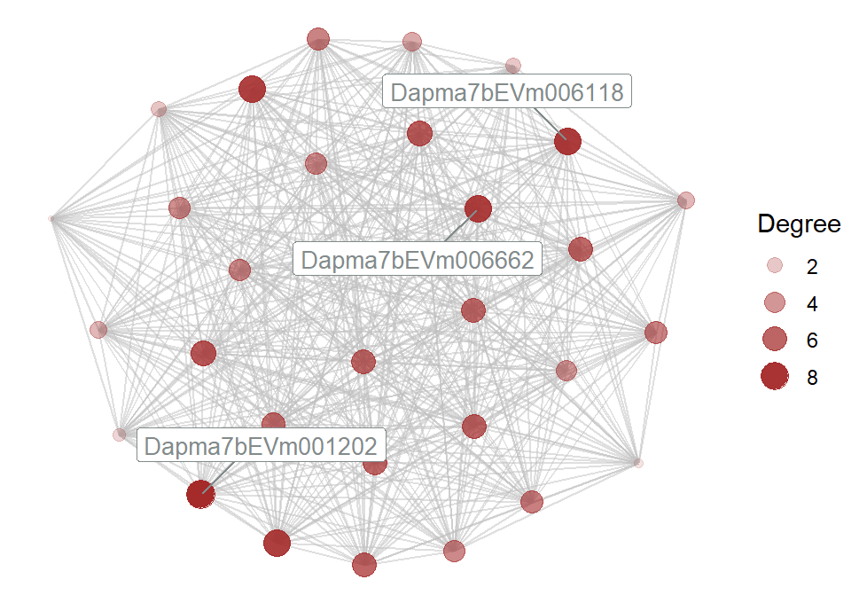
WGCNA result –brown module
Specific to Group1
Negatively correlated to Group1 water treatment
31 genes
Most of the hub genes don’t have orthologs
No significant enrichment detected
APOD

Slide 14
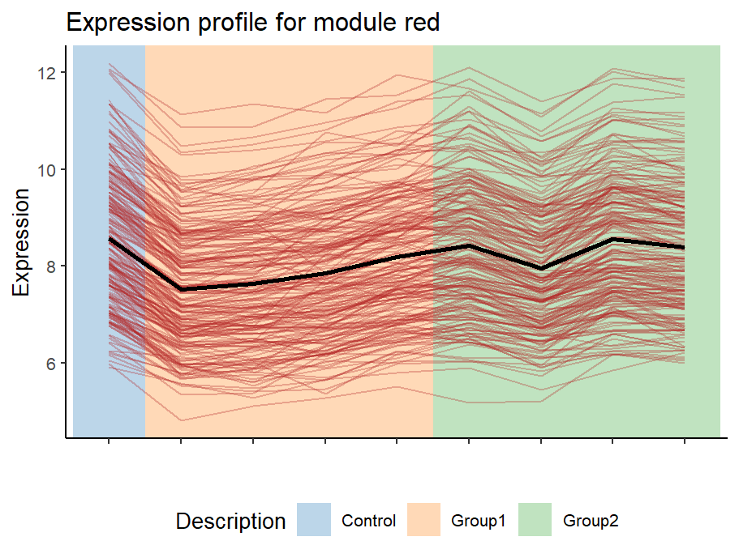
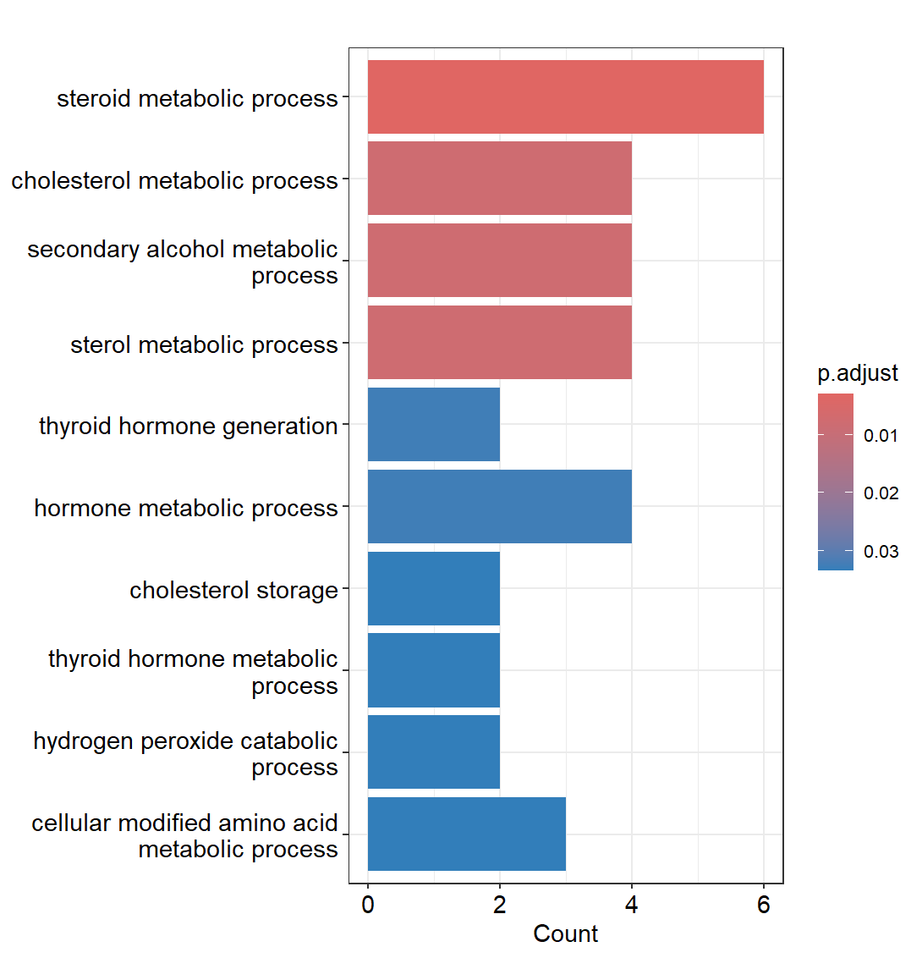
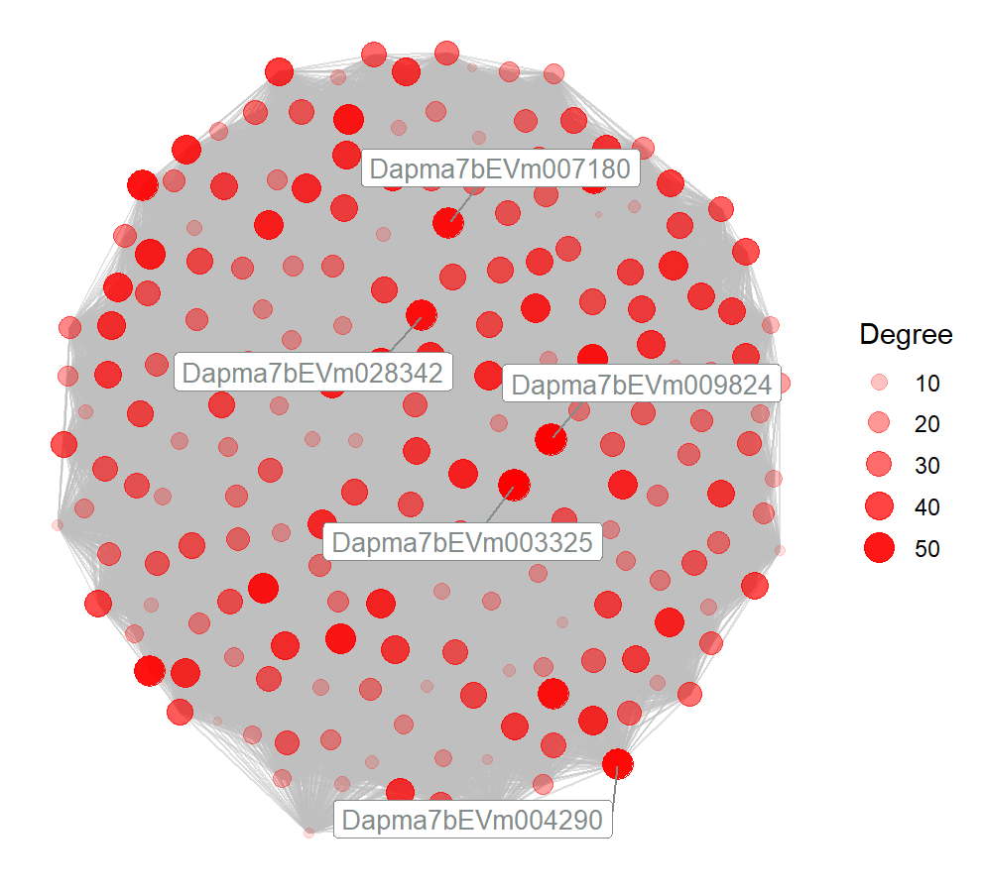
WGCNA analysis –red module
Specific to Group1
Negatively correlated to Group1 water treatment
199 genes
Hub genes don’t have orthologs

Slide 15
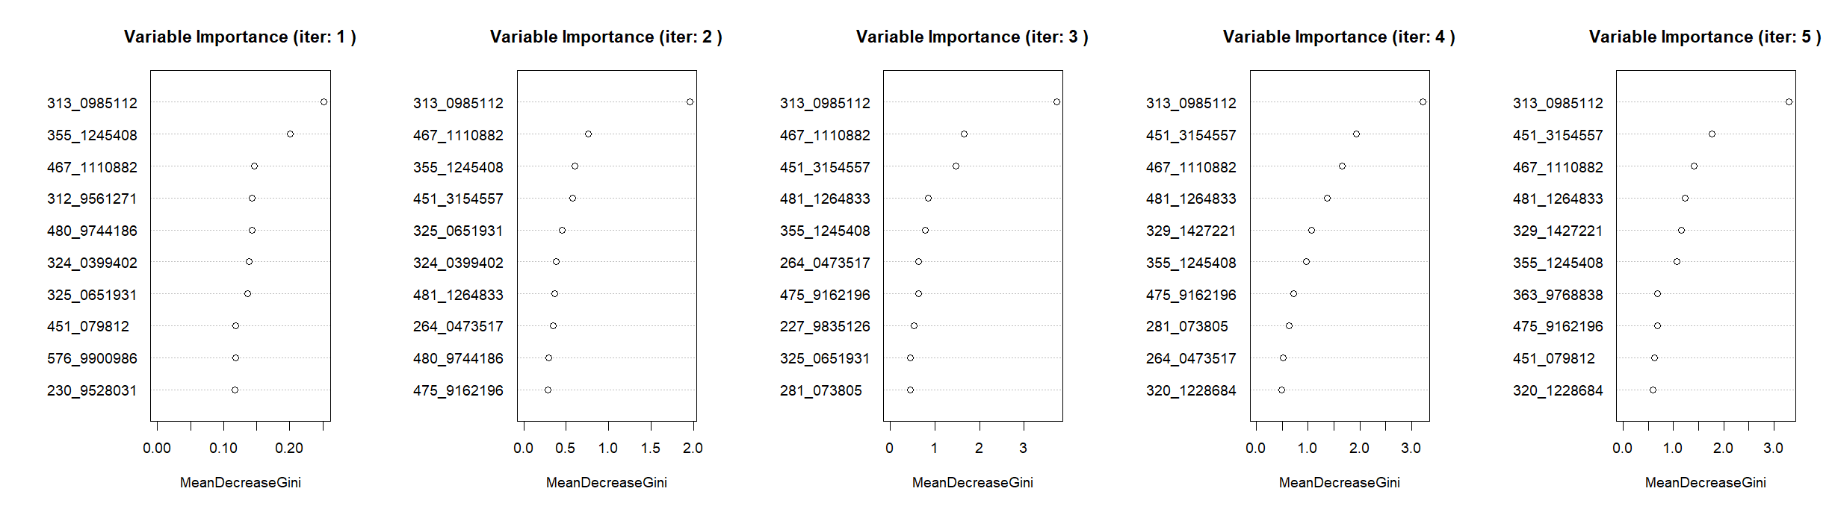
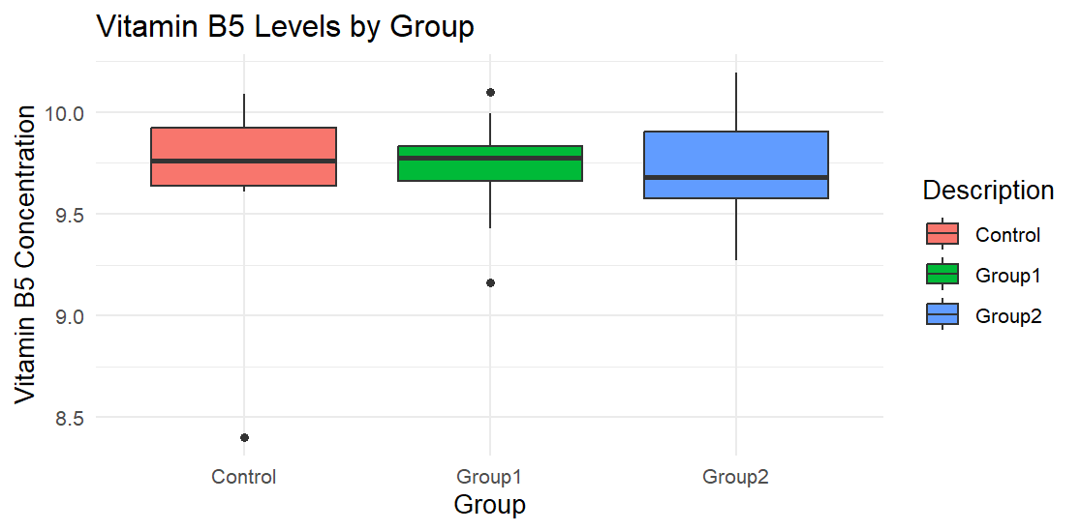
IRF-Important Features in Polar Negative Metabolomics Data

Slide 16
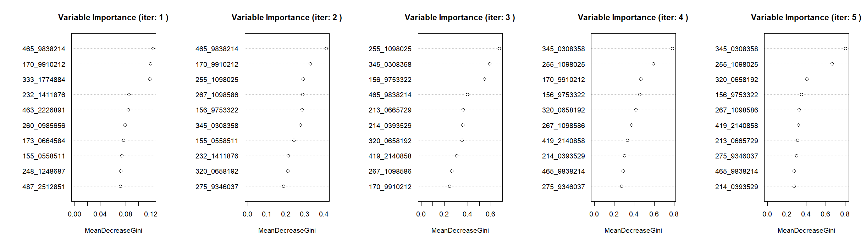
IRF-Important Features in Polar Positive Metabolomics Data
There was no metabolite for 345_0308358 peak_id.

Slide 17
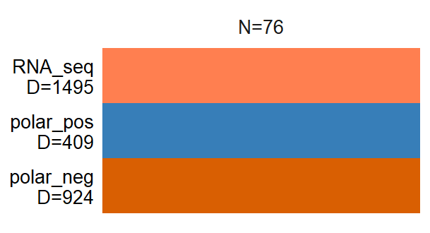
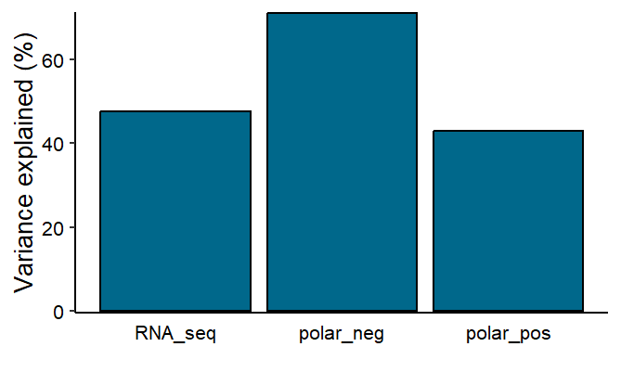
Multimodal analysis with MOFA
General overview of modalities
Total variance explained

Slide 18
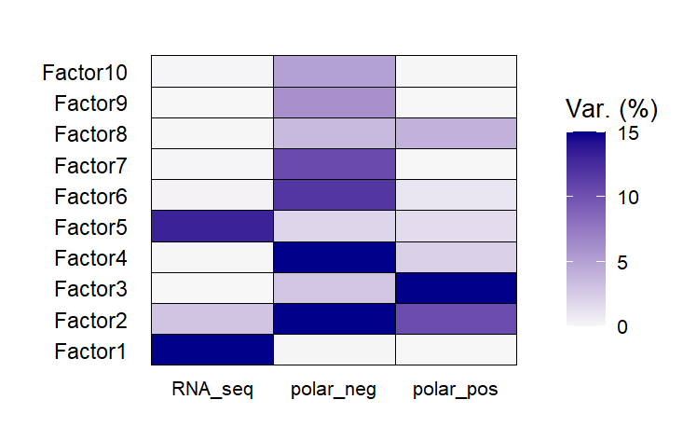
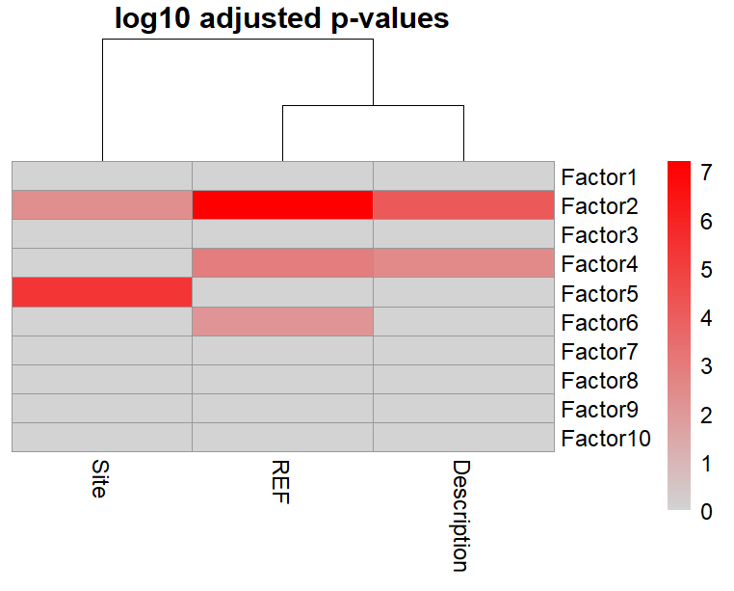
Variance decomposition by Factor
Multimodal analysis with MOFA
Association analysis

Slide 19
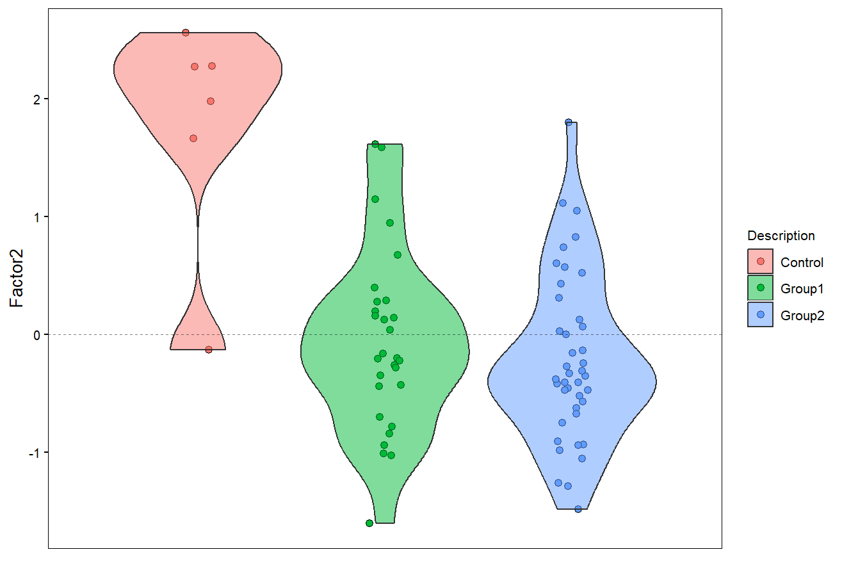
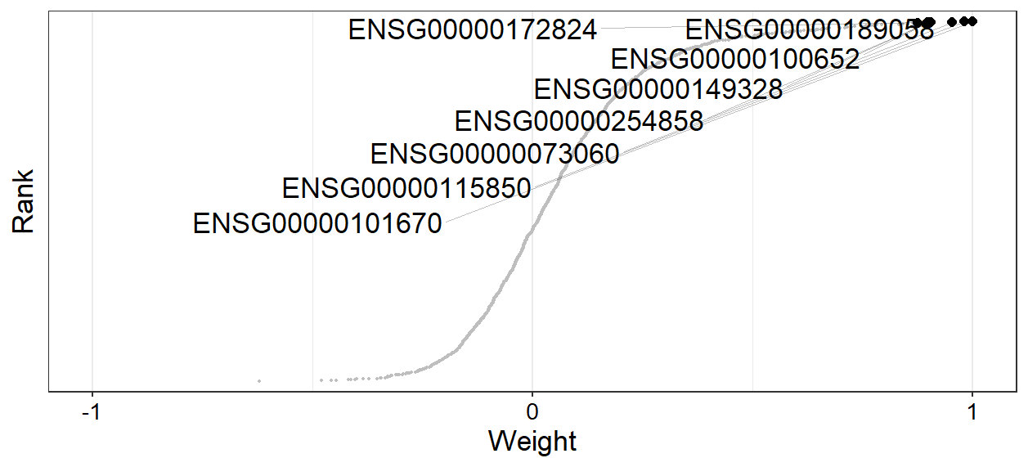
Characterisation of Factor 2-RNA_seq view
Factor 2-Group view
Plot feature weights
CES4A
APOD
SLC10A1
GLB1L2
MPV17L2
SCARB1
LCT
LIPG

Slide 20
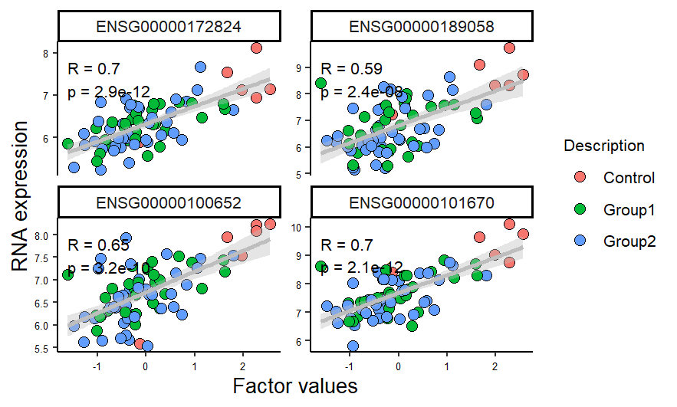
Characterisation of Factor 2-RNA_seq view
Factor 2-RNA expression- positive direction
Factor 2-Group view
CES4A
MPV17L2
SLC10A1
LIPG

Slide 21
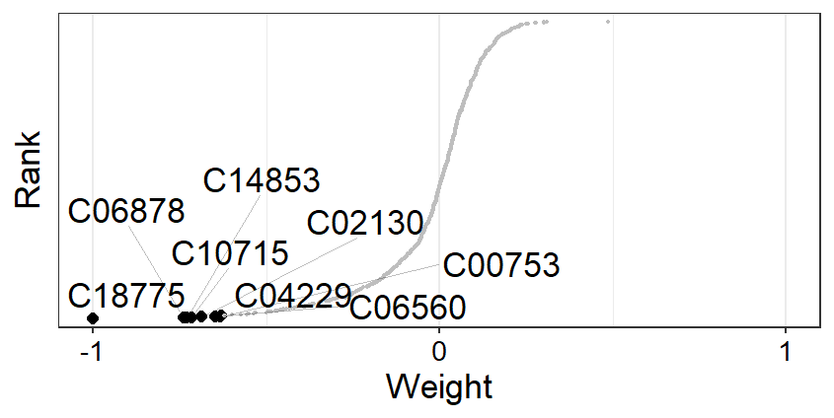
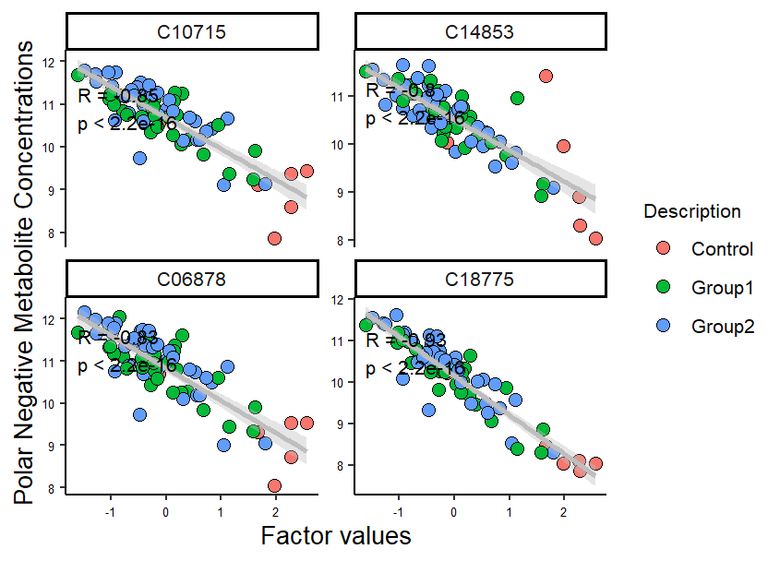
Characterisation of Factor 2-polar negative view
Benzo[a]pyrene
Cefadroxil
Acetyl-maltose
Paeonolide
Tungsten
Benazolin
Indolepropanol phosphate
Deisopropyldeethylatrazine
Factor 2-Group view

Slide 22
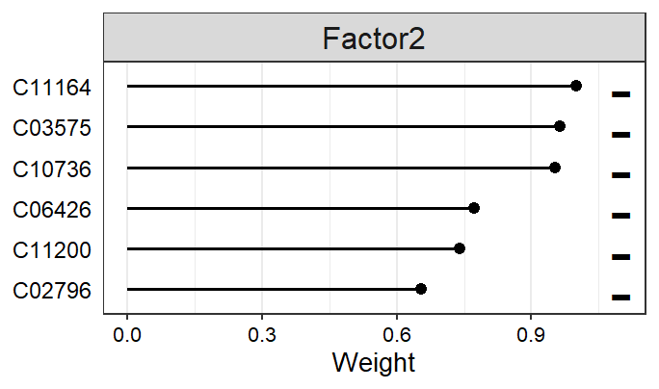
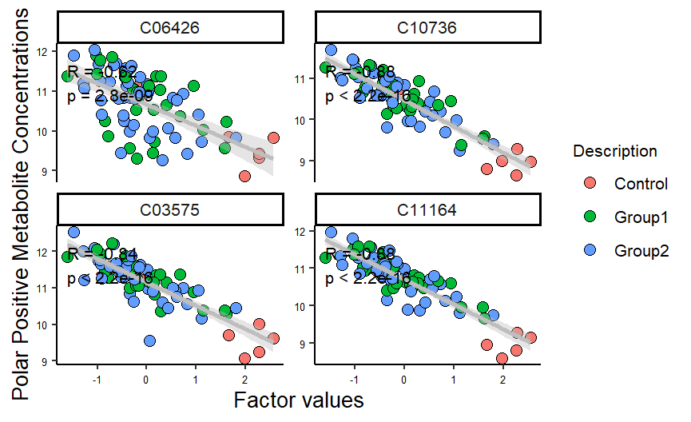
Characterisation of Factor 2-polar positive view
Carbonyl cyanide
Iodophenol O-methyltransferase
Robustine
alpha-linolenic acid (ALA)- Omega3
Lenacil
3-Methyleneoxindole
Factor 2-Group view

Slide 23
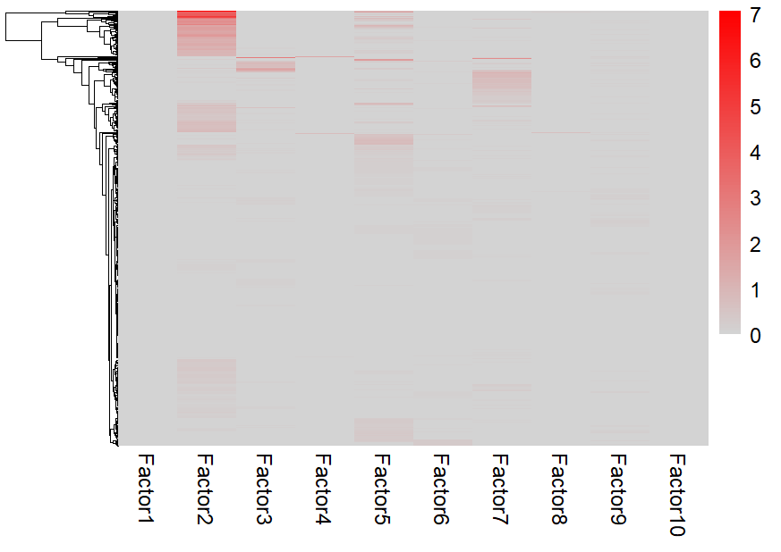
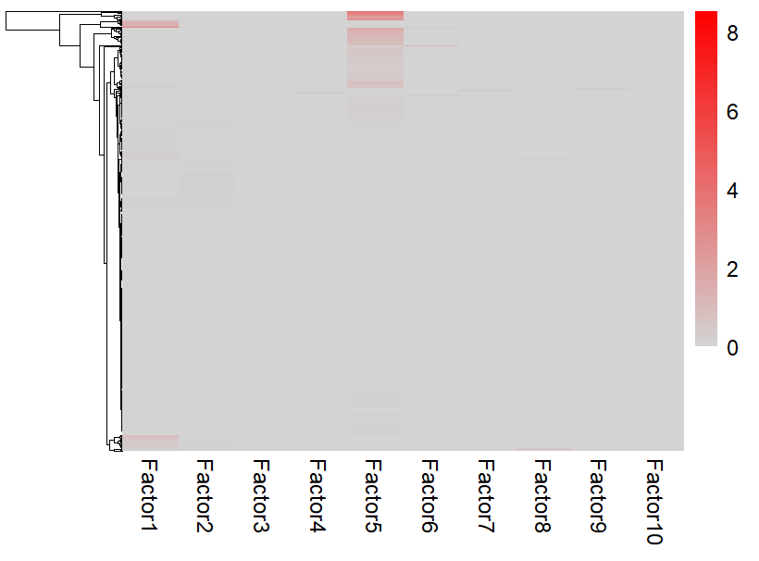
Gene set enrichment analysis (GSEA)
Positive weighted genes
Negative weighted genes
Reference Database: MSigDB_v6.0_C5_human

Slide 24
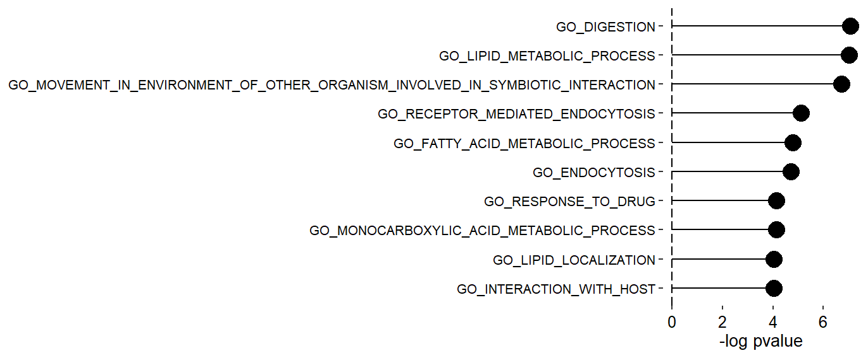
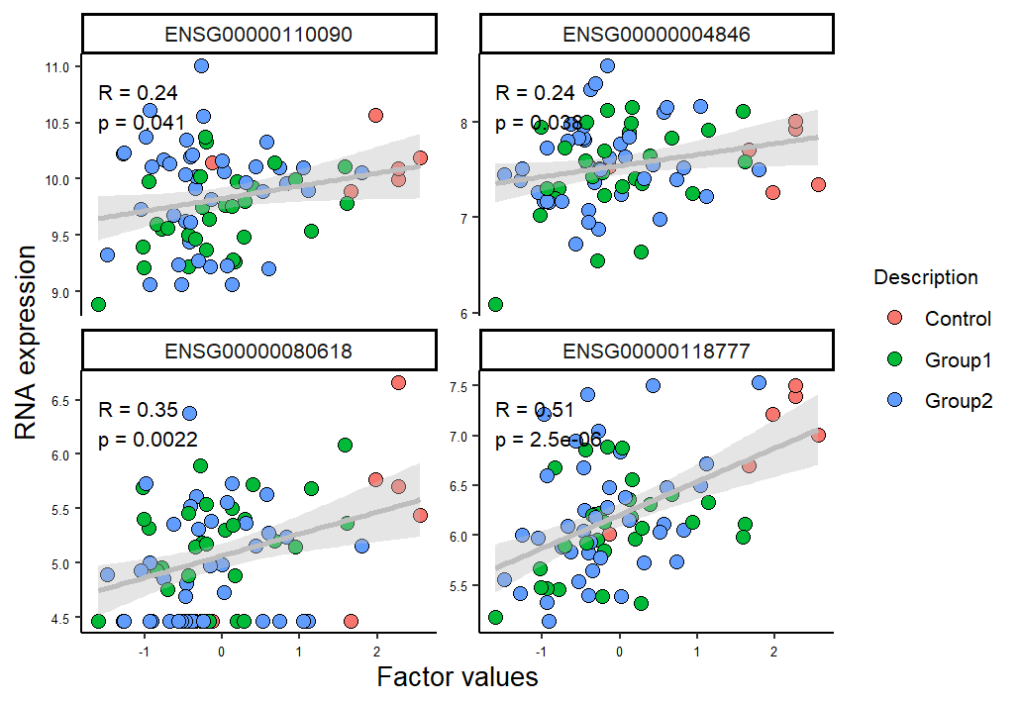
GSEA-Factor2-Positive
Factor 2-Group view
GSEA on positive weights
Drug Response
CPT1A
ABCB5
CPB2
ABCG2

Slide 25

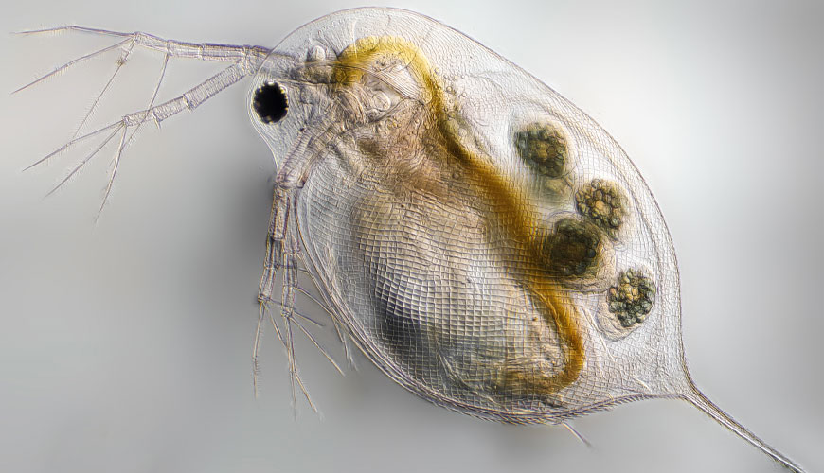
Summary
Data was imbalanced.
Some sites were outlier.
Mapping caused loss of information.
No significantly upregulated genes associated with toxic response pathway detected.
?
http://tinyurl.com/2s4k2rpe
http://tinyurl.com/mpr8wavp

